Slide 1



System Partner Thematic Review
Partners updates at 18-months
Sportengland.org

Slide 2
Executive summary (1 of 3)
Working as a consortium, Ipsos, New Philanthropy Capital (NPC), and Sheffield Hallam University (SHU) were commissioned by Sport England to undertake the Collective Evaluation and Learning for System Partners.
This report presents a thematic analysis of the 18-month reporting submitted by System Partners which described self-assessed progress against their goals, and the learning amassed as a result. It includes reporting updates provided by 125 System Partners for the six months spanning April 2023 to September 2023.
The analysis underpinning this report replicates a pre-existing process, including the use of pre-existing analytical frameworks. The next wave of reporting will involve a significant shift. It will be structured around the evaluation Theory of Change which should reduce repetition.
Uniting the Movement (slide 9)
System Partners continued to provide ample examples of activities being undertaken with the aim of improving performance against the four Uniting the Movement (UtM) outcomes.
Some System Partners provided data on increased SPA participation levels, and numbers of programme and training participants, as examples of their impact. Examples of increased participant diversity were also evident although less information was provided about the strategy behind targeting particular groups.
Other forms of impact (such as the impact of working in greater partnership/ collaboration) continued to be less directly evidenced although there was some emerging insight into the value of working with partners to develop access into new communities.
Progress against KPIs (slide 6 and 11)
The majority of System Partners (78%) reported progress against their goals that was considered to be either ‘Significant’ or ‘Some’ progress and nearly half (47%) have completed at least one goal. As previously, System Partners were more likely to have made ‘Some’ progress as opposed to ‘Significant’ progress. Only small numbers were considered to have made ‘Limited’ or ‘No’ progress at the 18-month mark.
System Partners were better able to describe progress against their goals than to document learning although the gap is closing.

Slide 3
Executive summary (2 of 3)
The quality of information provided by System Partners was broadly good, however, there remains room for improvement (in both the information provided by System Partners but also the clarity of what is asked of them).
System Partners also acknowledged that time was required to build the connections and collaborations that working in an increasingly place-based systemic way necessitated. In the 18-month returns there was more discussion about how they are now starting to build on the foundations established in the first year, starting to utilise relationships and pilot ideas designed to support new strategies.
Development Goals (slides 17)
The greatest challenges facing System Partners continue to be:
  the cost-of-living crisis (which was thought to be affecting SPA participation levels and increasing the delivery costs facing clubs and providers) and
  workforce / capacity (both internally and with the organisations that they work, or hope to work, with).
System Partners have continued to direct substantial efforts on establishing 'Better Organisations', with a focus on aspects such as EDI, leadership, organisational strategies and structures, governance, safeguarding, and capacity building. Notable progress was also observed in ‘Better Connected Systems', evidenced by activities such as collaborative events centred around SPA, bringing together partners from within and outside of the SPA sector. System Partners have also demonstrated ‘Better Community Impact’ through reflective learning practices that resulted in impacts such as the provision of community run programmes and increased participation figures.
Partner Learning and Impact Model (slide 13-15)
As the PILM has largely been subsumed into the Theory of Change it is unlikely this section will appear in the 24-month reporting. Therefore, this report identifies examples of activities, impacts and learning relating to different parts of the PILM model so that SPs seeking to focus on different aspects can be inspired by other SPs who are making progress.

Slide 4
Executive summary (3 of 3)
Emotions (see full report)
Although not reviewed in depth, the data was checked to ensure that no substantial shift had occurred. ‘Achievement’ words continue to be selected most often by System Partners to describe their feelings or emotions towards their work (including words such as ‘confident’, ‘energetic’, ‘valued’ and ‘engaged’). ‘Challenge’ words were the second most commonly selected though these predominantly included emotions such as ‘hopeful’ and ‘optimistic’.
Talent Review (see full report)
Predominantly, the work of Talent System Partners between 12-18 months focused on reviewing Talent pathways and making improvements, focusing on how to increase diversity (particularly among women, lower socio-economic groups, children and young people, and those with disabilities), continuing to deliver research into barriers to participation and actioning findings from these insights and providing coaches with training opportunities.. Reported impact and progress related to: successfully diversifying Talent, reaching diverse groups, better engaging athletes, improving competition and improving retention..
Recommendations and next steps (see full report)
Moving forwards, Sport England (working alongside the evaluation and learning consortium partners) may wish to consider the following based on the content of this report. This advice is similar to that provided in the 12-month reporting as, while some progress has been made for the 24-month reporting, there is still more work to be done:
  How well System Partners’ goals align with the UtM outcomes and whether or not they are ‘completable’ in their current form.
  How System Partners can be better supported to evidence their impact and learning.
  What support Sport England can provide to help System Partners respond to the challenges they face (see below for a quick win).
  What can be streamlined in terms of data collection (to minimise the reporting burden placed on System Partners whilst ensuring the necessary insight is gathered) and collective analysis/ reporting (to speed up the process and maximise the utility of reporting outputs).

Slide 5

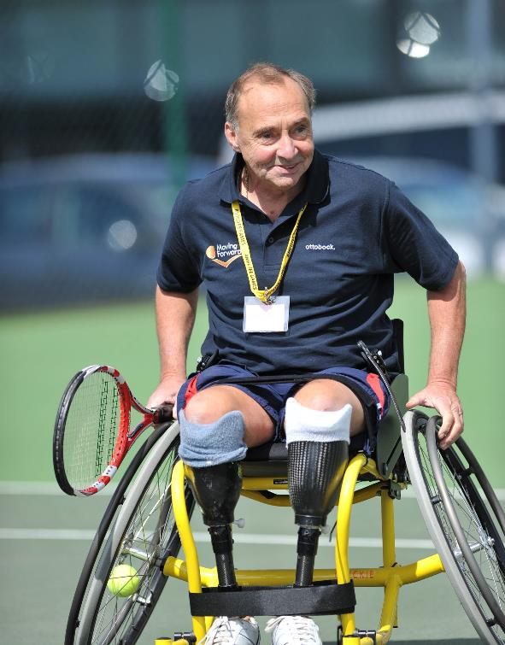
Progress against KPIs – overview and commentary

Slide 6
KPI Dashboard
Base: System Partners - 123

Slide 7
Commentary: progress between 12 and 18 months
Period largely focussed on consolidation & building on foundations.
Strategies largely agreed and in place
  New staff in place (especially in communications, marketing, EDI / CYP)
  Restructures complete
  Move towards training / embedding new strategies
Shifting to embedding new ways of working
  Strengthening and building on relationships that have been developed (e.g. more schools now engaged, seeking to get further into schools, e.g. now being actively approached, e.g. groups of APs, NGBs and NPs working together)
  Potentially new challenges emerging with regards to maintaining relationships (rather than building them)
Starting to apply principles / try things out / pilot
  Sometimes more successful than others (e.g. reflection that ideally would have allowed more time for co-production)
  Some demonstrating increased focus on (under-represented) target groups
New mechanisms in place to collect info / data – currently largely focussed on establishing baselines and priorities
Expansion of NGBs, contraction of APs – across all groups concern about the risk of creating appetite that cannot be resourced
Particular mention improvement of Talent pathways in NGBs
Updates from NPs sometimes less persuasive / more likely to be missing

Slide 8
Progress against UtM outcomes

Slide 9
Summary of progress against UtM outcomes
System Partners continued to describe plenty of activities being undertaken with the aim of improving performance against each of the four Uniting the Movement (UtM) outcomes. Activities tended to focus on:
  Increasing activity/ decreasing inactivity: programmes and events to encourage SPA participation, working in partnership to reach target audiences continue and some new initiatives are now becoming self-sustaining. SPs are continuing to build insight to inform strategies and develop new ideas to engage wider audiences. Some are reporting increased participation, while others are optimistic that this will come.
  Narrowing inequalities: work continues on internal EDI processes (e.g. diversifying their workforce, developing and implementing EDI strategies), but more emphasis on external activities including co-designing programmes and communication campaigns with groups of interest, building partnerships with a diverse range of organisations to have more inclusive reach, and better use of data to inform activities.
  Improving the experiences of CYP: supporting the School Games and upskilling School Games Organisers remains important as well as working with schools/ teachers more broadly to promote SPA. Some are reaching out to young people for the first time and supporting clubs to do this. Finding ways to ensure that youth voice is used to shape activities is also continuing.
System Partners were most able to describe impact through traditional ‘outputs’ such as participation numbers. Other forms of impact (such as the impact of working in greater collaboration with other organisations) were less easily evidenced. Nonetheless, there is some mention of SPs working together and collaborating on different topics and examples of SPs successfully influencing other organisations in their systems.

Slide 10

Progress, learning and quality of information: Scores

Slide 11
Summary of progress, learning and information quality
123 System Partners provided an update against their original goals and were included in the analysis. It was not possible to include 6 System Partners in the analysis, due to incomplete data. Using pre-existing analytical frameworks, an overall assessment of a) evidence of progress/ impact, b) evidence of learning and c) quality of information was undertaken across all goal updates for each System Partner.
Over three quarters (78%) of System Partners have progressed towards achieving their goals. This is down from 92% at 12 months. Similarly to 12 months, System Partners were more likely to have made ‘Some’ progress. National Partners were most likely to demonstrate evidence of ‘Significant’ progress towards their goals.
Nearly three quarters (73%) of System Partners are generating ‘Significant’ or ‘Some’ evidence of learning. This has increased from 67% at 12 months. Levels of learning varied depending on goal type, with learning less evident for Governing goals.
The quality of information provided by System Partners was broadly good with most updates providing thorough detail and evidence (41%). However, there is still some room for improvement with 28% marked as ‘Needs improvement’ (slightly up from 27% at 12 months), suggesting more clarity and guidance is needed around what is asked of System Partners.
78% of updates show significant/some progress
73% of updates show significant/some learning
41% of updates have ‘good’ quality of information

Slide 12
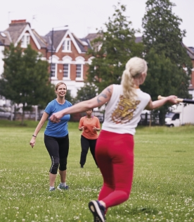
The Partner Learning and Impact Model (PILM)

Slide 13


Better Organisations
The Partner Learning and Impact Model (PILM) was a model co-created by Sport England and System Partners to capture what they wanted to learn, and were intending to impact, through their work. The model consists of 3 domains: Better Organisations, Better Connected Systems, and Better Community Impact.
This section of the report highlights key examples of the activities, impact and learning of System Partners in relation to Better Organisations. This domain is about understanding and demonstrating change in organisational effectiveness.
Akin to the 12-month reporting there was a continued focus from System Partners on:
Focusing on EDI and striving to become more inclusive.
Refining organisational strategies and structures.
Adhering to the Code for Sports Governance.
Focusing on safeguarding.
Building capacity through recruitment and new initiatives.

Slide 14

Better Connected Systems
This section of the report examines the activities, impact and learning of System Partners in relation to Better Connected Systems. This domain is about understanding and the connections between different parts of the system, and the difference they are making.
In relation to this domain, System Partners focused on:
Building relationships within local systems to drive and influence the SPA agenda.
Collaborating with organisations to generate an understanding of needs and how to address them.
Developing events and initiatives to continue turning the dial on equality and diversity in sport.

Slide 15

Better Community Impact
This section of the report examines the activities, impact and learning of System Partners in relation to Better Community Impact. This domain is about understanding the impact System Partners are having on the individuals and communities they serve.
Activities being undertaken by System Partners in this domain predominantly focused on:
Enhancing the opportunities for involvement in SPA
Direct collaborations with community members to expand reach.
Designing programmes and promotional strategies in collaboration with target demographics, such as young people.
Improving communication and marketing strategies to promote inclusivity in messaging.

Slide 16

Challenges faced by System Partners and their Development Priorities

Slide 17
Summary of Challenges and Development
Priorities
SPs continued to face a range of challenges which restrict progress, including the rising cost of living, after effects of the pandemic, workforce, evaluation and measurement and working with local partners and Sport England.
As part of the investment process System Partners identified their own organisational Development Priorities in relation to six criteria that underpin organisational effectiveness. 115 System Partners reported on these. In the main, these link very closely to the Better Organisations domain of the Partner Learning and Impact Model (PILM). The activities undertaken by System Partners for each Development Priority tended to focus on:
  Values, purpose and strategy: continued refining of their organisational strategies, embedding organisational values, developing People Plans, recruiting and restructuring roles.
  Understanding people and communities: focused on lived experience, greater use of data and insight to inform activities (drawing on data and evidence from partners), developing and embedding EDI strategies.
  Partnerships and collaboration: broadened and deepened relationships with other organisations (including those with a non-SPA focus and with access to key populations of interest), developed shared visions with other partners.
  Leadership: continued focus on recruiting new Board members and senior leadership, implementing organisational plans and strategies, undertaking leadership training, and understanding leadership role within the system.
  Capacity and capability: recruited and restructured teams to improve capacity and capabilities, and where partners can provide support.
  Learning and continuous improvement: continued to build a reflective learning culture, utilise data and evidence gathered, and improve efficacy of information dissemination.

Slide 18


Thank you

Slide 19
Appendix

Slide 20

Overview of methods
As part of the System Partner portfolio of work, Sport England asks System Partners to submit 6-monthly self-reported updates of progress towards their self-defined goals, alongside other information. These updates are submitted online via SmartSheet and are then analysed at the aggregate level.
For the 18-month reporting, 125* System Partners submitted updates which were analysed thematically.
The reporting activities aim to
  provide Sport England with an overview of progress against System Partners’ goals (including progress/ impact and learning);
  build understanding about how System Partners’ activities links with Sport England’s wider strategic objectives and contribute to the long-term outcomes for UtM (e.g. increasing activity, decreasing inactivity, narrowing inequalities, and improving the experiences of children and young people); and
  in time – will be used to inform the Collective Evaluation and Learning activities and outputs.
An analytical approach and framework for reviewing the System Partner updates at 6-months was developed by Ecorys and Sport England in early 2023 (and was replicated by the Collective Evaluation and Learning partner for the 12-month report). A revised approach was agreed with Sport England for the 18-month report, which sought to streamline the approach, and there was further refinement of the review criteria to make them clearer.
An additional aim for this reporting activity is to streamline the analysis and reporting process. Based on this wave, new guidance has been produced for the 24-month reporting. We are exploring with Sport England opportunities for alternative approaches to analysis and reporting for future reporting rounds including revisiting the goals to ensure they are SMART.
*two SPs did not provide goal updates but provided updates against other reporting fields (e.g. summary statements).

Slide 21
Methodological limitations
The analytical methodology has some limitations which should be considered by readers. These are outlined below:
This report draws on analysis of a total of 1,177 goal updates across 123 System Partners which were reviewed in depth and ascribed a progress rating (representing 50% of all goal updates submitted by System Partners). System Partners were able to develop their own goals according to the different roles they play within the system (e.g. Systemic, Talent) – meaning there is considerable variance in the type of goals being pursued. In some cases, this presents a challenge for meaningful aggregation.
System Partners’ goal updates vary considerably in terms of content, quality and level of information. The scale and diversity of information submitted through the reporting is also vast. This poses a significant challenge for reporting consistent and comparable findings.
The updates provided by System Partners are all self-reported. Where examples of impact and learning are cited, the quality of evidence supporting System Partners’ updates has not been checked. The nature of this data, and the means in which it is reported, must therefore be treated carefully to not overstate progress or impact.
It is also noted that examples of activities being undertaken, impact and learning provided by System Partners did not have associated timescales. It has therefore been assumed that all updates are within the 12-18 month reporting window.
This report is a thematic analysis and aggregation of the System Partner reports. It is not a critical assessment of the quality of System Partners’ reports, or a deeper exploration of the contexts, mechanisms, and theories underpinning evidence presented in the reports. Nor is it – yet – a piece of analysis which maps onto the overarching programme Theory of Change which is still in development.

