Slide 1
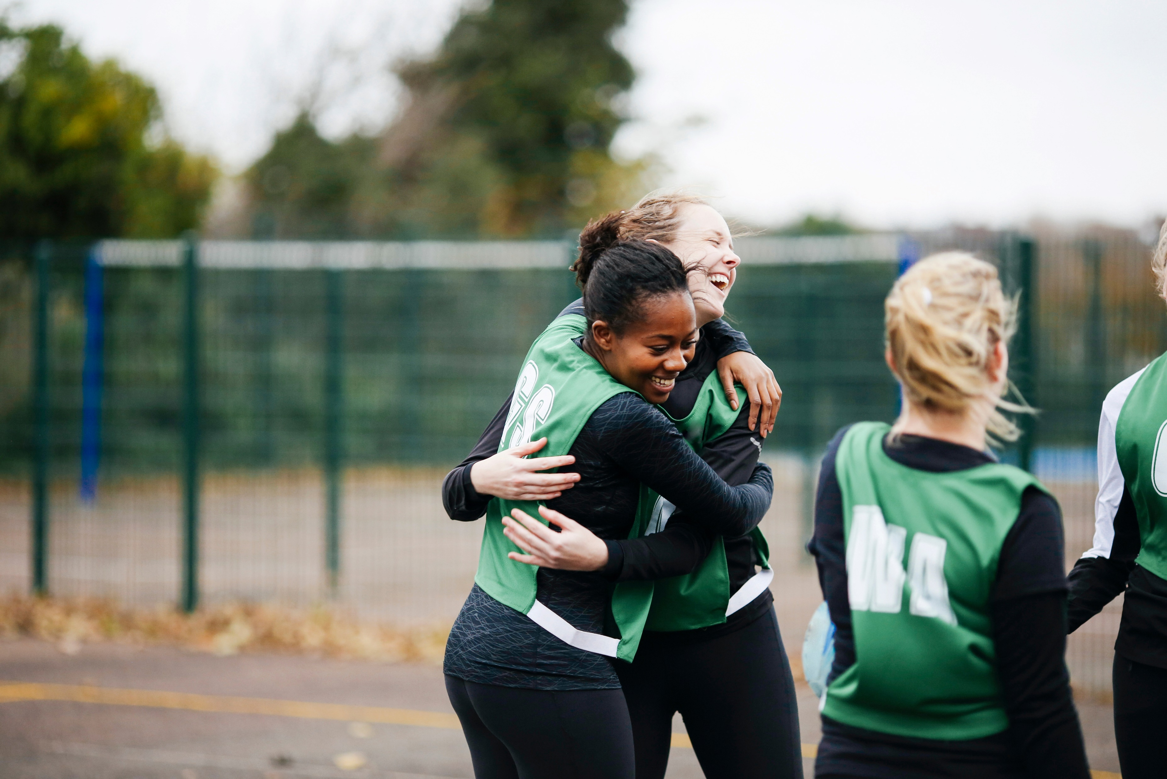
Active Lives Children and Young People
Device-based measurement guide
Sportengland.org

Slide 2
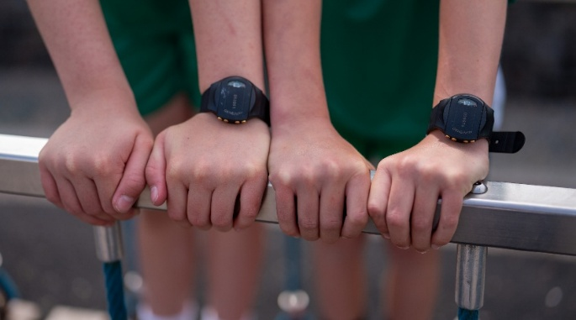
Device-based measurement
The survey measures engagement in, and attitudes to, sport and physical activity among children and young people in school Years 1-11
Pupils in all selected classes are invited to complete the online survey
Pupils in TWO of the selected classes are also invited to wear a movement monitor on their wrist to measure how much movement and rest they do across a week
  The movement monitor is a GENEActiv device from ActivInsights
  For short we call it ‘Genie’
We would like pupils to wear a Genie 24 hours a day, for 7 consecutive days
Genies are worn on the wrist and look like a black faceless watch
It does not have a screen, camera, Internet or Bluetooth connection
It is waterproof and comes fully charged
Genies do not record location or send any live data whilst they are wearing it
Schools & pupils are not responsible if a Genie gets lost or damaged

Slide 3
Recruiting schools
What do APs need to do?
Ipsos will give you a sample of schools (four schools per term from the main sample) and from this list APs will need to recruit one school per term for the device-based measurement. If more than one school agrees please select one of those agreeing. All of the schools should be asked if they would do the survey even if they do not agree to or are not needed for the device-based measurement.
When do APs recruit schools?
It is recommended that APs make initial contact with schools before the end of the previous term (or before the start of term for the autumn term). This can then be followed up with confirmation and additional information when the term has started.
How many classes are taking part?
Three classes per school are invited to complete the online survey and two of these selected classes are invited to also wear Genies. APs will be given pre-assigned year groups to select, regardless of which school is recruited. Within the pre-assigned year groups usual processes should be used to select one class if needed.
A whole class will be invited to take part. If there are high consent rates at the school, not every pupil will receive a Genie. We will let you know if we cannot provide Genies to all pupils who have consented. Ipsos will randomly select pupils if more pupils than we have Genies for consent to take part.
Are there any materials available to help APs recruit schools?
There are invitation materials to send to schools including an invitation letter and school guide. We also have an initial contact email template you can use to contact schools.

Slide 4
School sample breakdown
School
School
School
School
School
School
School
School
Invited to survey
Invited to survey
Invited to survey
Invited to survey
Invited to survey & DBM
Invited to survey & DBM
Invited to survey & DBM
Invited to survey & DBM
Completes survey
Completes survey
Completes survey
Completes survey
Completes survey only
Completes survey only
Completes survey only
Completes survey & DBM
  One class completes survey ONLY
  Two classes complete survey & DBM
Only one school completes device pilot.
Only two of the three classes wear devices

Slide 5
Encouraging participation
What could motivate schools to take part?
Schools will receive two reports (one for survey results and one for device-based measurement).
They will also receive extra credits to buy equipment for every class that wears a Genie for 7 days.
What difference will taking part make?
This is an opportunity for the school to help shape and inform an important new development on this study
Support and flexibility
Schools can choose when in the term to take part (6 possible weeks). The sooner they decide the more choice they will have about which week they can take part. The Active Partnership will be there to support with the consent process, answer any questions etc. The devices will be delivered to their schools with all the information and materials needed to take part and will be collected afterwards.

Slide 6
School support
How can you support schools to take part?
Contact the school. You can use the initial contact email template
Send the school the invitation leaflet
Follow up with a phone call or email to answer any questions
Obtain their consent to take part
Send the school guide and other information documents
Guides have been produced to help schools take part in the Survey. The school guides are designed to help schools understand what the survey and a Genie is, how they take part and the incentives for doing so
You will need to send the school:
  the pupil invitation leaflets
  the parent invitation letter
  consent form templates
  privacy notices

Slide 7
Selecting classes and pupils
How do we select which class in a year group wears devices?
As for the main survey class selection, all classes in a selected year group should be listed in alphabetical order based on teacher surname / class name / equivalent. The last class in this list is the class who should be invited to wear Genies. This will be repeated for each selected year group.
Classes should still be mixed ability and, where applicable, mixed gender.
What if a school’s class / year group set-up does not allow classes to be selected this way?
Please contact Sport England if you or a school are unsure as to how best to select classes based on the school’s set-up.
Why can schools not select their own classes?
This is to remove bias towards classes for any reason and to ensure that the responses are as representative as possible.
Who should be invited?
All pupils in the 2 selected classes (one in each selected year group) should be invited to take part and given the consent information. If there are high consent rates at the school, not every pupil will receive a Genie. We will let you know if we cannot provide Genies to all pupils who have consented. Ipsos will use an ID number from the consent process to tell APs and schools which pupils to give Genies to.

Slide 8
Information for schools
What do schools need to do before receiving the Genies?
The school will need to send out a letter/email to parents of the children in the selected classes to inform them that their child is invited to take part in wearing a Genie for the survey.
The school will also need to send out the invitation leaflets to the selected classes to inform the pupils that they have been invited to take part in wearing a Genie.
There are three invitation leaflets:
One for Year 1-2 pupils
One for Year 3-6 pupils
One for Year 7-11 pupils
Schools will also need to send out the consent form with the parent letter and invitation leaflets.
There are two different consent forms:
One for parents of Year 1-6 pupils which includes a question to answer with their child
One for parents of Year 7-11 pupils which includes a question for their child to answer
The school guide provides links to the template letters and consent forms. Schools should use their own online systems for obtaining consent using the provided templates and then report to you the number invited and the number consenting. Schools should send out the forms 2 weeks before the week they are due to have the Genies.

Slide 9
Managing the Genies
How will schools get the Genies?
Schools will be sent the Genies by the University of Exeter who are working in partnership with Ipsos
How to organise the Genies being sent to schools?
Once a school has agreed to take part, please log this in Smartsheet
There is separate sheet for school management and another for the Genie management
Check which weeks Genies are available (early in the term there will be more choice)
Ask the school the 7-day period when the school would like the pupils to be wearing the Genies
Re-check the availability of the Genies and book in a ‘slot’ and confirm with the school
Schools will have the Genies across a 10-11 day window
Agree the date schools will distribute Genies to pupils. This should ideally be a Wednesday (or Thursday) to avoid courier delivery and collection falling on the weekend. Schools need to stick to the agreed date for handing out and not do so earlier or later
Genies will be set to start ‘recording’ at midnight on the day of arrival
The Genies will be sent to the school via courier to arrive one day before they are due to hand them out to pupils
Make sure you have collected the name and contact details of the correct teacher and department and upload this information onto Smartsheet
This will allow the University of Exeter to send the Genies to the correct school address
Warn the school that Genies will arrive during school hours, when reception staff are available and ideally in the morning. Ask if there are any special instructions required
Let the school know when the University of Exeter will despatch the Genies, so they are aware of their imminent arrival
Follow up with the school to make sure the Genies have arrived and have reached the correct member of staff
Check with schools the date they have distributed the Genies and log this on Smartsheet
Smartsheet will also indicate the date on which schools need to collect the Genies in. This will be 8 days after handing them out
A courier will be booked to collect the Genies and the feedback forms from the school the next day

Slide 10
Managing the Genies
What will schools receive?
For schools:
  One page sheet itemising contents and explaining key points
    Date of return
    How to confirm the date with courier
    Option to return late Genies
  Printed list of Genie device numbers with space for the teacher to write the pupil name allocated for each Genie
    This document will highlight that it should be treated as confidential
    Feedback form for teachers
Return information:
  Box for returning Genies
    Retain box they were delivered in for return
  Information on packaging
  Return post address label
  Spare Jiffy bags for any late returns
    Royal Mail addressed and prepaid
For pupils:
  The Genies
  Genie information booklets for pupils (one per pupil with a Genie)
  Sweat bands for protecting the Genie
  Tubi grip bandage for pupils who cannot wear the Genie on their skin
    Only for pupils with a specific reason such as skin sensitivities or sensory issues
  Feedback form for pupils
  Thank you certificates for pupils, once Genies have been collected

Slide 11
Collecting the Genies
What happens when pupils have worn the Genie for 7 days?
Schools will need to organise collecting the Genies from pupils on the eighth day (so the pupil has 7 complete days to wear the Genie). They should ask pupils to complete the feedback form when they return their Genie. The school will collect these in and return them with the Genie. There is also a feedback form for the teacher.
They will then package the Genies back into the box they were delivered in with the pupil and teacher feedback forms, ready for the courier to collect them on the pre-agreed collection date.
What happens if a Genie gets lost or damaged?
Schools, pupils and parents are not responsible if a Genie gets lost or damaged. Schools have been asked to let their AP know as soon as possible if this happens. Please log this on Smartsheet. We will be unable to send the school a replacement Genie.
Do schools have to do anything else?
Schools need to make sure that the pupils who have worn a Genie, also complete the online Active Lives Survey. This is very important and the only way their data can be included.
The pupils will need to enter their Genie device number into a box at the start of the survey so we can match the Genie data to their survey responses. This means they need to complete the survey before handing their Genie back. If pupils don’t have their Genie the teacher can refer to their list of numbers.

Slide 12
Managing the Genies
.
How will University of Exeter use the data?
Once the Genies are received back at the University of Exeter, they will download the data
University of Exeter will process the raw data to create agreed variables indicating when pupils are active, sedentary, and when they were not wearing the Genies
Ipsos will match these data to the main processed survey data
Combined Genie data and survey data data will be sent to Sport England without an identifier for the school – they will not know which school the data comes from
There will be no individual pupil-level reports
The University of Exeter will also analyse the data from the pupil and teacher feedback forms

Slide 13
Incentives for schools
1
2
School Report
Schools will receive:
Reports on their school’s data
Ipsos will email the report on their online survey data*
Ipsos will also email a report on device-based measurement indicating the numbers consenting and taking part at your school. This will not include data referencing sleep patterns or bedtimes.
There are no individual pupil-level reports.
Equipment Incentive
Schools will receive:
For completing the online survey: 10 credits (worth ~£100) to spend on equipment
Credits for completions by Y1-2 parents
For device-based measurement: Extra credits (worth £75) for every class that takes part
Survey report example:
Yr 1-2 only
Survey report example:
Yr 1-6 or Yr 3-6
Survey report example: Yr 7-11
* Provided at least 25 responses are completed. Response numbers will affect the level of detail in the report.

Slide 14
Incentives for schools
3
School Participation Certificate & Pupil Thank You Certificate
Schools will receive:
A device-based measurement participation certificate for the school congratulating them on their completion
A thank you certificate to give to pupils who have participated and pupils who consented but were not selected
4
Healthy Schools Rating Scheme
Schools will receive:
A rating certificate for the school to display. Issued only as part of the school report
Ratings are calculated based on the teacher response
This is a Department for Education scheme - further information

Slide 15
Smartsheet
The logging and communication of information is essential to the success of the study. On the school sheet you should record:
Whether and when the school was invited to take part in the device-based measurement
Whether the school agreed
Which week (choice of 6/7 per term) it would like to take part and date to receive Genies (avoid Fridays)
Contact name and address for receiving device (plus email and telephone number)
Date that the Genies will be collected in by the teacher (automatically generated)
Date that the Genies will be collected from the school (automatically generated)
Number of pupils in each selected year group invited and number consenting
Whether Genies have been received at the school
Whether Genies have been returned (according to the school)
The research team will confirm that all surveys/ Genies have been returned and teacher list of devices can be destroyed – AP to inform the school
A device level sheet will be used for recording:
School name and URN and Device number
Whether Genie has been sent to school
Whether survey received for that case (research team record this and AP use this for checking with school)
Whether device has been received back (research team record this and AP use this for checking with school)
Whether device has been reported lost or damaged (AP record this)

Slide 16
Any questions?
Active Partnerships have access to:
  This guide
  A webinar at the start of the year
  A webinar part way through the autumn term
  A debriefing webinar at the end of the year
  All the materials for schools, pupils and parents
  Smartsheet with information about which weeks are available
If you have questions which cannot be answered from these sources then please contact the Sport England team on activelives@sportengland.org

