Slide 1

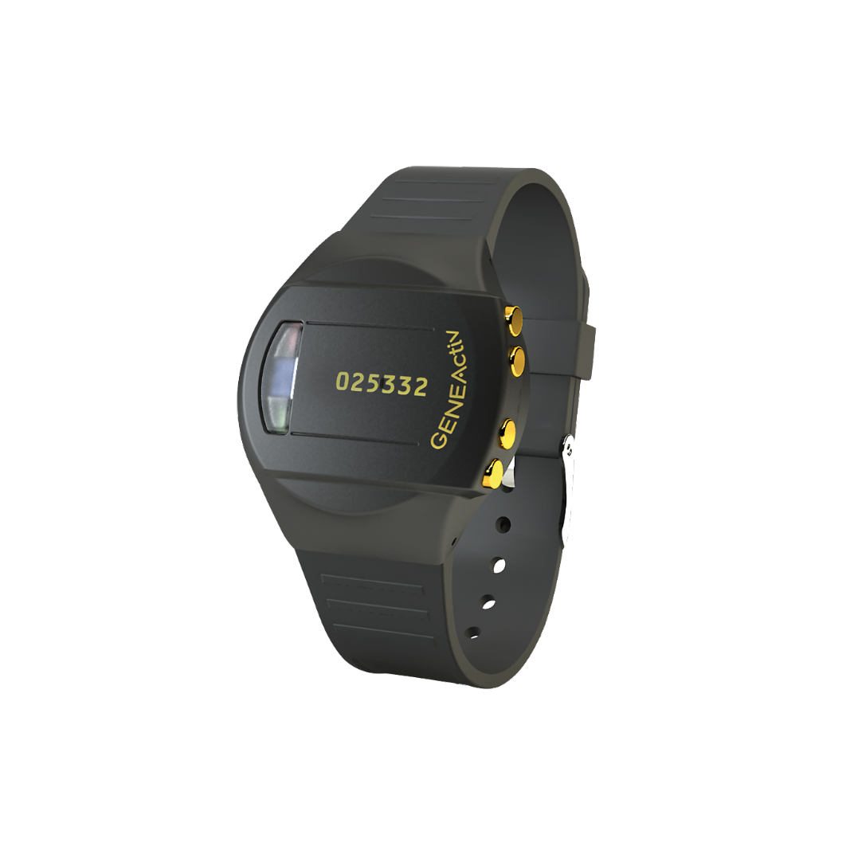

School guide
Movement monitor information
Simple steps
1
Active Lives
Children and Young
People survey
Understanding pupils’ levels of participation and attitudes to
sport and physical activity to help them move more.
Background
2
Select classes
3
Contact parents
Click to
learn more
Movement monitor
4
5
Participation
Incentives
For further information please contact your
Active Partnership, or read our latest report
6
FAQs

Slide 2
1
Background
Your school has been selected to take part in the Active Lives Survey
Pupils in all selected classes are invited to complete the online survey
Please read the separate school guide for the online survey completion first
Pupils in two of the selected classes will also be invited to wear a movement monitor on their wrist, to measure their movement and rest. It is very important these pupils also complete the online survey
The movement monitor is a GENEActiv device from ActivInsights. For short we call it ‘Genie’
We would like pupils to wear a Genie 24 hours a day, for 7 consecutive days
All movement data is stored on Genie. It does not measure location or send any live data
There is no camera, smart display, internet or Bluetooth connection
Genies come fully charged. They do not need charging
The invitation leaflet gives an overview of the study
Invitation leaflet
Online survey school guide

Slide 3
1
Background
This is a pilot to understand the feasibility of introducing movement monitors into the Active Lives Survey
The aim of this pilot is to gather data on:
  Response: school participation, pupil and parent invitation and consent rates
  Adherence: Genie return & failure rates, proportion pupils providing valid data
  Linking movement monitor data to the online survey using the Genie number
To help us understand and evaluate how Genies are used in schools, please provide your Active Partnership with:
  The exact number of pupils in each selected class that are invited
  The exact number of pupils & parents that consent to take part
  Details of any issues you experience with the Genies e.g. lost/damage, missing
It is really important that both teachers and pupils fill in the feedback forms provided as this is valuable information to help us understand your experience of taking part

Slide 4
2
Select classes
Your Active Partnership will tell you which year groups have been selected to complete the online survey, which is up to 3 per school
Your Active Partnership will tell you which two of these year groups have been selected to wear Genies as well as complete the online survey.
There may be another year group that takes part in only the online survey
Two classes will be asked to wear a Genie. One class* per year group. Please see the main school guide for how to select one class in each year group
All pupils in the selected classes must be invited to take part wearing a Genie, as the purpose of this study is to test consent rates
If there are very high consent rates in your school, not every pupil will receive a Genie but your Active Partnership will let you know if this is the case
Why? We ask you to select classes this way and invite all pupils within them to ensure that it is a random selection, so we achieve a representative sample of pupils
Main school guide
* Classes should be mixed ability and when applicable they should also be mixed gender. If all classes are mixed year groups, both year groups can complete (excluding Reception). For further information and help, please contact your Active Partnership.

Slide 5
2
Select classes
Year group 3
One class invited to complete survey
Completes online survey
only
Year group 1
One class invited to complete survey & wear a Genie
All pupils in class complete online survey
Year group 2
One class invited to complete survey & wear a Genie
All pupils in class complete online survey
Invite all pupils in the one class to both
Invite all pupils in the one class to both
Some pupils also wear a Genie
Some pupils also wear a Genie
Main school guide

Slide 6
3
Contact parents and pupils
Contact parents or guardians of pupils in the selected classes to let them know their child’s class has been invited to wear Genies two weeks before you will receive the Genies.
You will need to distribute the parent invitation letters, pupil invitation leaflets and consent forms electronically using your own school system with the wording and information provided by the Active Partnership. You can print these out if required but we recommend online consent using the system you usually use for permission forms.
You need to collate the consent forms and record who has consented to take part (both parent and pupil). Pupils can only take part if both parent and pupil consent. Inform the Active Partnership about how many have consented.
Invitation letter, leaflets and consent form templates are available below:
Consent forms
Parent invitation letter
Pupil invitation leaflets

Slide 7
3
Contact parents and pupils
Year groups 1-6
  Please distribute the parent invitation letters and Y1-2 or Y3-6 invitation leaflet (depending on year groups selected)
  Parents of year 1-2 pupils, will also need to be sent the online survey letter
  There is one consent form, which parents need to fill in with their child (both parent and child need to consent)
Year groups 7-11
  Please distribute the parent invitation letter and Y7-11 invitation leaflet
  There is one consent form, which parents need to fill in with their child (both parent and child need to consent)
  Both parent and pupil need to sign the consent form, for the child to take part

Slide 8
4
Receiving the Genies
You need to inform your Active Partnership how many pupils were invited and how many pupils have consent to take part (from both pupil and parent)
Ipsos will randomly select pupils to wear Genies, from those who have consented (using an ID number to tell you which pupils)
You need to agree with your Active Partnership the participation dates for completing the online survey and wearing Genies
The agreed hand out date for Genies to pupils, should ideally be a Wednesday (or Thursday) to avoid courier delivery and collection dates falling on a weekend. It is very important that you hand out the devices on the day you have said you will (not earlier or later)
Provide your Active Partnership with teacher contact details and the school address for the Genies to be sent to
Genies will be sent to your school to arrive one day before you are due to distribute them to pupils, via courier
You will receive the Genies, a list of Genie device numbers, Genie information booklets to give to pupils, sweat bands and Tubi grip to wear with the Genie if needed, thank you certificates, feedback forms for you and the pupils, return postage information

Slide 9
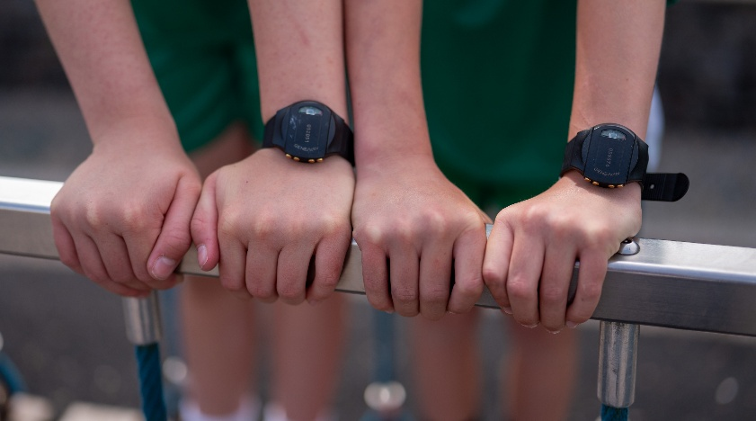
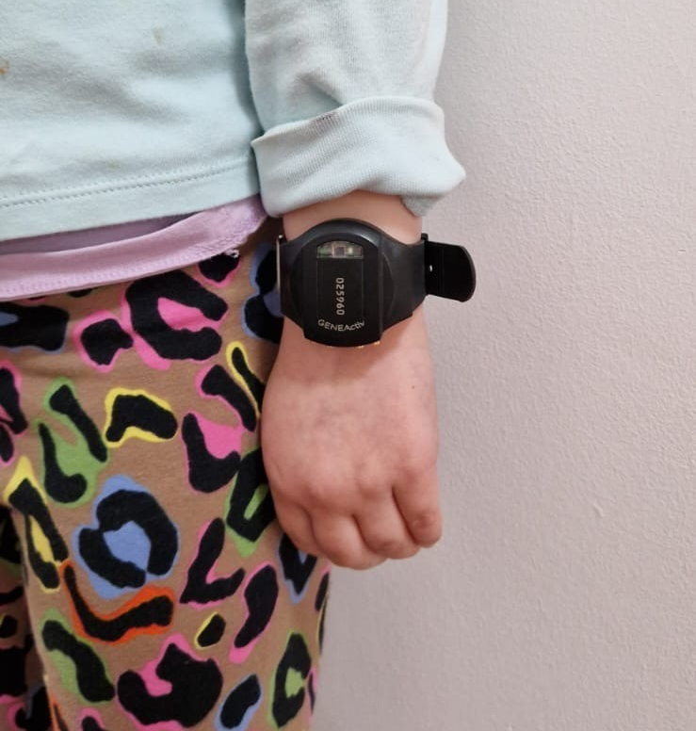

4
Genie distribution
Set a time for pupils to collect their Genie during school. You may need to help pupils put the device on their non-dominant wrist
Record which pupil receives each Genie. We will provide you with a list of Genie device numbers - you must record the child name against the right device number
Genies should be tight enough on the wrist so that they do not move
The gold buttons need to be close to their hand if on left wrist and pointing to elbow when on right wrist. The pupil should be able to read the number on the front of their Genie
Genies will start automatically, you do not need to press anything
The Genies are set to start at midnight on the day of arrival at your school. It is important that you hand the Genies out on the agreed date. If possible hand out the Genies on a Wednesday (or Thursday)
If you have to change the date you hand out the Genies, your pupils must still wear the Genie for 7 full consecutive days. Please inform your Active Partnership if the distribution date changes
Data is collected and processed
by Ipsos and the University of Exeter
FAQs on Genie

Slide 10

4
What happens if the pupil is ill/absent when distributing?
If one of the pupils selected to wear a Genie is unwell or absent on the day of distribution, please give it to the same pupil the following school day
  If you are handing out Genies on a Friday and a child is absent, follow the steps below instead. The best hand out days are Wednesday (or Thursday)
If the pupil is absent for longer than a day or on a Friday, please allocate the Genie to another pupil (ensuring both parent and pupil have consented) and record the correct child name against the device number. We will tell you the ID number of the reserve pupils
If there is not another child that has consented to take part, do not hand the spare Genie out and let your Active Partnership know

Slide 11
4
What happens if the Genie is lost/damaged?
If a Genie gets lost or damaged, please inform your Active Partnership as soon as possible
The school and pupil/parent are not responsible for the Genie
You/the pupil will not be charged or have to pay any money to fix or replace the Genie. We understand that accidents happen
It is not possible to send you another Genie
The pupil can still complete the online survey

Slide 12
4
What happens if pupils have to take off their Genie?
Genies are waterproof so they can be worn during swimming lessons, washing and any other activities involving water
We have provided Tubi grip bandage for pupils to wear under their Genie, for particular skin sensitivities or sensory issues
We have also provided sweat bands which pupils can put over the Genie to protect it or other pupils, during sport or play. These should not be worn under the Genie. Pupils can keep the sweat band afterwards
If pupils/class have to remove their Genie, for a lesson or other activity, please provide a safe place for them to store it
Please remind the pupil/class to put their Genie straight back on again
FAQs

Slide 13
4
Genie collection
After 7 consecutive days, please set a time to collect the Genies from pupils during school. You should collect them on the eighth day (e.g. if you gave them out on a Monday collect them the following Tuesday). Ideally hand them out in the afternoon and collect them in during the morning to minimise the extra time pupils have them beyond the 7 wear days
It is very important pupils complete the online Active Lives survey during the week when they are wearing a Genie (this can be at any point during the week including on the day you collect them)
They will need the Genie number they wore and will need to enter it in the online survey before completing, so we can match their survey answers to the Genie data. This means the survey needs to be completed while they still have their Genie
Check with your Active Partnership if you are unsure which pupils have/ have not completed the online survey
Please ensure pupils complete the paper feedback form about their experience of wearing a Genie
Complete the teacher feedback form
Online survey guide
Y1-6
Online survey guide
Y7-11

Slide 14
4
Genie return management
Collect the Genies 8 days after you handed them out to the pupils. Ideally collect them early in the day so that pupils who wear them until they hand them back are not wearing them for longer than necessary
A courier will collect the Genies from your school on a pre-agreed date. Your Active Partnership will arrange this with you
Spare Jiffy bags have been included in the Genie box. Please use these if a pupil is absent on the day of collection and you need to return a Genie separately from the main courier collection
Spare Jiffy bags are Royal Mail addressed and pre-paid
Please return the paper pupil feedback forms in the same box with the Genies as well as the teacher feedback form. For year 1-2 pupils please send the pupil feedback form home so parents can complete the form with their child and return it to school. Year 3-11 pupils can complete at school.
Information

Slide 15
5
Your rewards
1
2
School Report
You will receive:
Reports on your school’s data
Ipsos will email you with your report on your online survey data*
Ipsos will also email a report on device-based measurement detailing the numbers consenting and taking part at your school. This will not include data referencing sleep patterns or bedtimes.
There are no individual pupil reports.
Equipment Incentive
You will receive:
10 credits (worth ~£100) to spend on equipment^ for the online survey completion
1 extra credit (worth ~£10) for every parent response received (selected year 1 and /or year 2 classes only)
Additional credits (worth ~£75) for each class that takes part in wearing Genies
ESPO will email you after the end of term to claim your incentive
Explore the rewards
Survey report example:
Yr 1-2 only
Survey report example: Yr 7-11
Survey report example:
Yr 1-6 or Yr 3-6
^ Provided at least 25 responses are completed. Exceptions apply for schools with fewer than 60 sampled pupils.
* Provided at least 25 responses are completed. Response numbers will affect the level of detail in the report.

Slide 16
5
Your rewards
Healthy Schools Rating Scheme
You will receive:
A HSRS rating certificate for your school to display.** Issued only as part of the school report
  Ratings are calculated based on the teacher response
  This is a Department for Education scheme - further information
3
School Participation Certificate & Pupil Thank You certificate
You will receive:
A Genie participation certificate for your school verifying your completion
A thank you certificate to give to pupils who have participated and pupils who consented but were not selected
Pupils can keep the sweatband as a small thank you
4
** Provided that the score calculated from the teacher response is enough to award a rating.
Example certificate and letter

Slide 17
6
Genie information
Pupil Must Dos!
Wear for 7 consecutive days
Wear on non-dominant wrist
Wear for 24 hours a day
Wear for all activities (unless specific request due to health and safety concerns, e.g. contact sports)
Wear while sleeping
Wear while washing and swimming
Complete the survey in the week wearing a Genie
FAQs on Genie

Slide 18
6
Genie information
Can Dos
Wear a sweatband OVER to protect the Genie or other people during sport
Wear a Tubi grip UNDER if skin is sensitive/sensory issues
See Genie information booklet for more information on Can dos
FAQs on Genie

Slide 19
6
Genie information
For schools to note
Provide a safe place if pupils need to remove e.g. school tray or blazer pocket
No stickers or personalisation on Genies
Pupils should NOT swap Genies
Pupils moving their hand about randomly will not make a meaningful difference to their activity levels
FAQs on Genie

